Slide 1

Bike Sharing Demand Prediction
G.KARTHIKEYA 221FA14001

Slide 2
PROBLEM STATEMENT :
Currently Rental bikes are introduced in many urban cities for the enhancement of mobility comfort. It is important to make the rental bike available and accessible to the public at the right time as it lessens the waiting time. Eventually, providing the city with a stable supply of rental bikes becomes a major concern. The crucial part is the prediction of bike count required at each hour for the stable supply of rental bikes.

Slide 3
DATA DESCRIPTION :
The dataset contains weather information (Temperature, Humidity, Windspeed, Visibility, Dewpoint, Solar radiation, Snowfall, Rainfall), the number of bikes rented per hour and date informati
Date : year-month-day
Rented Bike count - Count of bikes rented at each hour
Hour - Hour of he day
Temperature-Temperature in Celsius
Humidity - %
Windspeed - m/s
Visibility - 10m
Dew point temperature - Celsius
Solar radiation - MJ/m2
Rainfall - mm
Snowfall - cm
Seasons - Winter, Spring, Summer, Autumn
Holiday - Holiday/No holiday
Functional Day - NoFunc(Non Functional Hours), Fun(Functional hours)
on

Slide 4

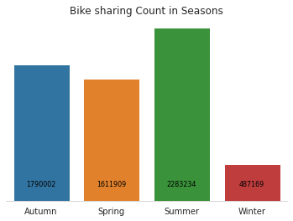
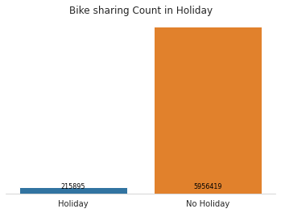
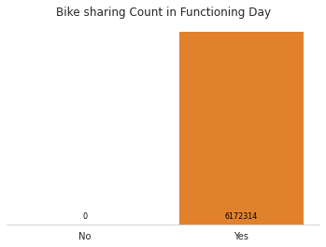
From the above graphs we can say
* Most number of Bikes are rented in Summer, followed by Autumn and Spring and Winter
* People prefer booking bikes on Working days more than the Holidays
* All the bikes were rented on the functioning day

Slide 5

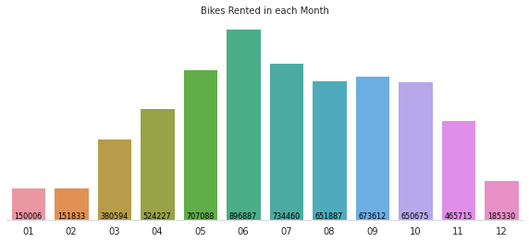
* June is the most preferred Month for bike sharing with around **896K** bike shared.
* July and May are the second best with total sharing of **734K** and **707K**. * Bike sharing was least in December and January with , **185K** and **150K**.

Slide 6

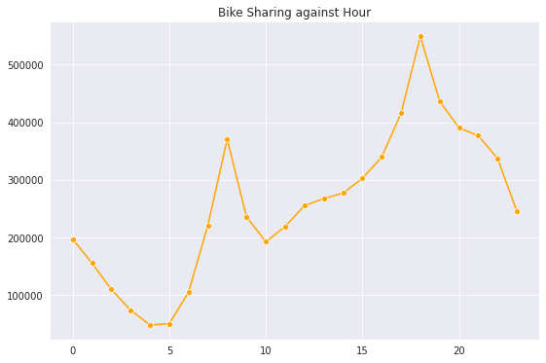
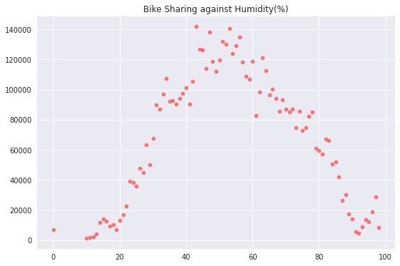
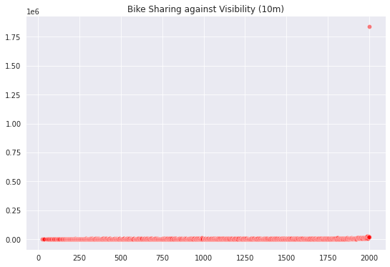
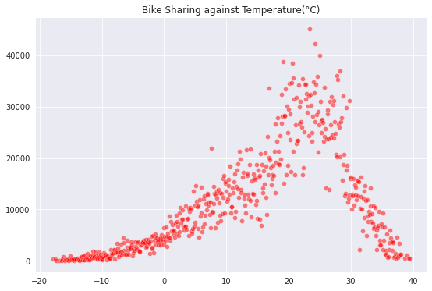
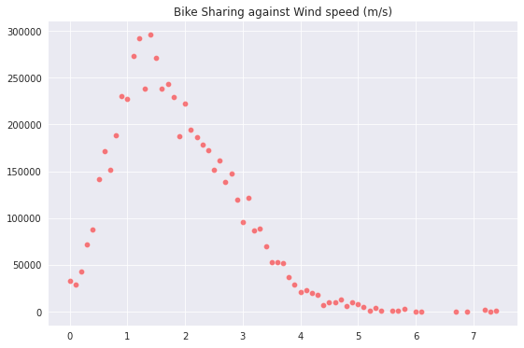
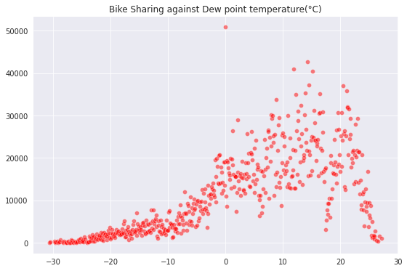
* Bike sharing is at its peak between **4pm- 6pm**
* Bike shaing is least between **4am-6am.**
* Most preferred temperature for bike renting is **20-30 Degree Celcius.**
* Bike sharing is least when temperatur is **< 5 and >35 Degree Celcius.**
* Humidity of **40%-60%** is most favourable for bike sharing.
* Wind speed of **1m/s -2 m/s** is most favourable for bike sharing.
* Bike sharing count is directly related to Visbility in the area.
* Dew Point Temperature of **5-25 Degree Celcius** is most favourable for bike sharing.
* **Optimum Solar Radiation, no rainfall and no snowfall** leads to higher bike renting in Seoul.

Slide 7
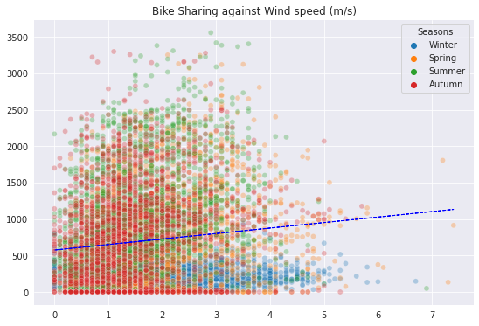
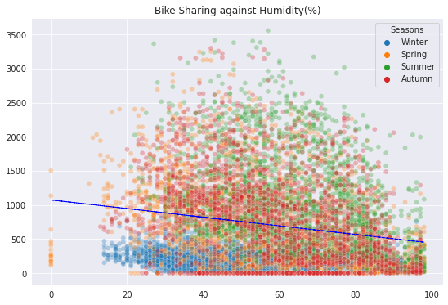
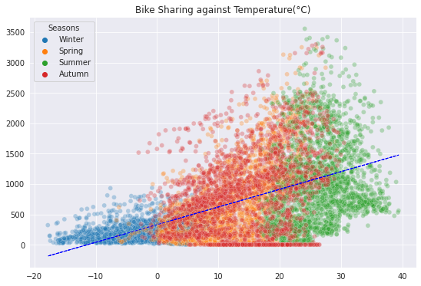
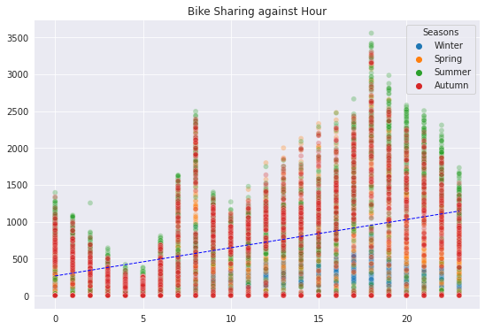
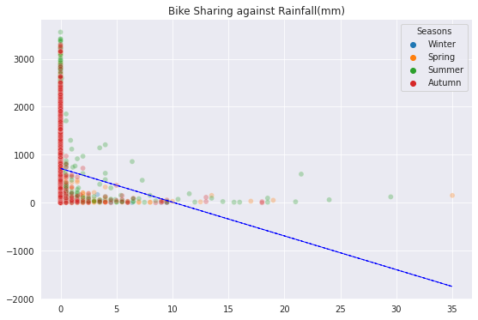
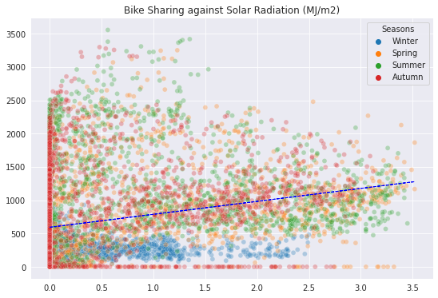
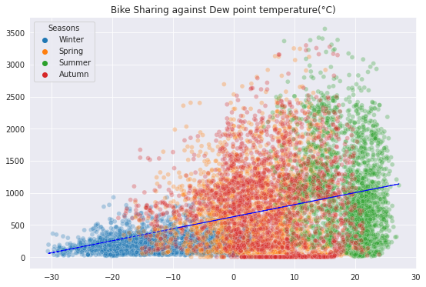
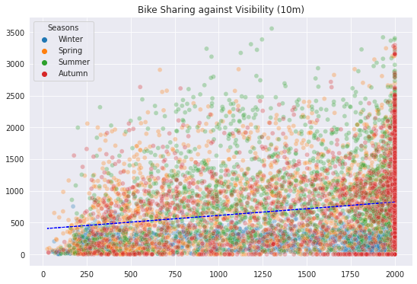
* Bike sharing count is positively co- related to Hour as the Hours Progress from 0 (12 am) to 20 (8pm) the bike sharing count increases. * Bike sharing is positively co-related to tempearature as the temperature approaches 30*C. * Though one thing to notice the positive co-relation is applicable only because temp is Seoul rarely crosses 40 Degress * Humidity, Snowfall, Rainfall, are negatively co-related to Bike rent count. * Solar radiation and Dew Point temperatuer are slightly positively realted to Bike sharing count.

Slide 8

REGRESSION VALUES:
Using Lasso regression the model accuracy has further reduced* R-Score is 0.55 and Adj R-score is 0.54
* Linear Regression model residual values ranging from -1500 to 2000.* lets see if we can reduce the width of this plot using other ML models
* Its evident that simple linear model is not giving us much accuracy. * R-score is 0.55 and Adj R-score is 0.54
* the Resdiual plot more or less remains the Same even with the Lasso Regression.* lets try Hyperparameter tuning to see if it improves our accuracy score.
* Accuracy using Hyperparameter as well is as below R-Score 0.55 and Adjusted R-score -0.54
MSE : 83584.74317257409
MAE : 164.45613015688554
RMSE : 289.1102612716714
R2 : 0.7585456177570638
Adjusted R2 : 0.7558485964386535

Slide 9

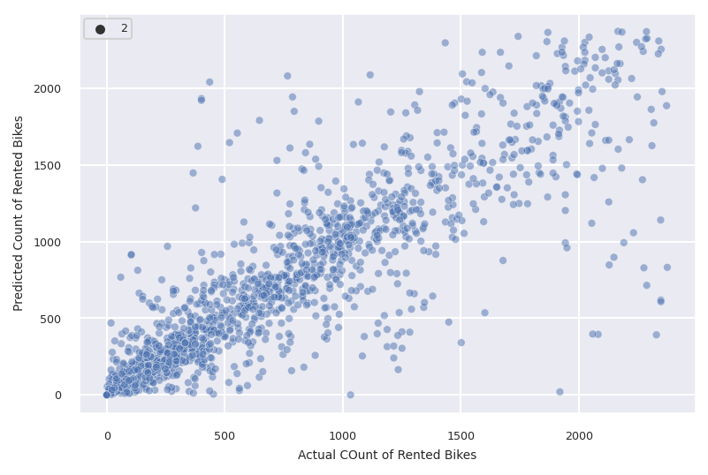
T-TEST WITH THE R SCOR CHECK
Decision tree improve the accuracy significanlty on the Test set with the R-score of 0.754 and Adjusted R-score of 0.751*
its evident from the above plot the Predicted and Acutal values are much closer compare to Linear Model.

Slide 10

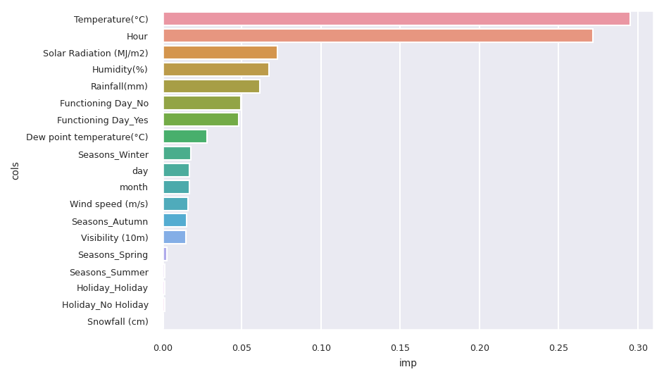
YOU COULD USE THREE COLUMNS, WHY NOT?

Slide 11
Linear Regression
# Import necessary libraries
import pandas as pd
from sklearn.model_selection import train_test_split
from sklearn.linear_model import LinearRegression
from sklearn.metrics import mean_squared_error, r2_score # Load the dataset
file_path = '/content/SeoulBikeData.csv'
data = pd.read_csv(file_path) # Select relevant features and the target variable
X = data[['Temperature(?)', 'Humidity(%)', 'Wind speed (m/s)']]
y = data['Rented Bike Count'] # Split the data into training and testing sets (80% training, 20% testing)
X_train, X_test, y_train, y_test = train_test_split(X, y, test_size=0.2, random_state=42) # Initialize the linear regression model
model = LinearRegression() # Train the model
model.fit(X_train, y_train) # Make predictions on the test set
y_pred = model.predict(X_test) # Evaluate the model
mse = mean_squared_error(y_test, y_pred)
r2 = r2_score(y_test, y_pred) # Display results
print("Mean Squared Error (MSE):", mse)
print("R-squared (R2):", r2)
print("Model Coefficients:", model.coef_)
print("Model Intercept:", model.intercept_)

Slide 12
Linear Regression
# Import necessary libraries for visualization
import matplotlib.pyplot as plt # Scatter plot of actual vs. predicted values
plt.figure(figsize=(10, 6))
plt.scatter(y_test, y_pred, color='blue', alpha=0.5)
plt.plot([y_test.min(), y_test.max()], [y_test.min(), y_test.max()], 'r--', lw=2)
plt.title('Actual vs Predicted Rented Bike Count')
plt.xlabel('Actual Rented Bike Count')
plt.ylabel('Predicted Rented Bike Count')
plt.grid(True)
plt.show()
Mean Squared Error (MSE): 254612.73004283317 R-squared (R2): 0.3888994859446995 Model Coefficients: [31.43287493 -8.55157035 33.49305828] Model Intercept: 737.9399628886097

Slide 13
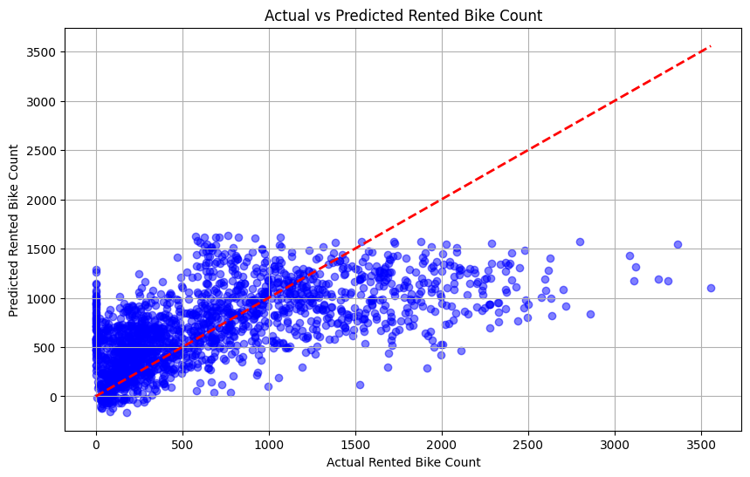

Slide 14
SUMMARY TABLE MODELS
# Summary table of ML models
from prettytable import PrettyTable
data_table = PrettyTable(['SL NO',"MODEL_NAME", "MSE", "RMSE","MAE",'R^2','Adjusted R^2'])
data_table.add_row(['1','Linear Regression','155676.033','394.558','301.067','0.550','0.545'])
data_table.add_row(['2','Lasso Regression','155673.688','394.555','301.060','0.550','0.545'])
data_table.add_row(['3','Gride Search CV',' 155675.866','394.557','301.067','0.550','0.545'])
data_table.add_row(['4','Decision Tree','83584.743','289.110','164.456',"0.754",'0.751'])
data_table.add_row(['6','Default_XG boost','44091.547','209.979','131.553','0.872','0.871'])
data_table.add_row(['7','Random Forest','42747.144','206.753','128.211',"0.876",'0.875'])
print(data_table)

Slide 15
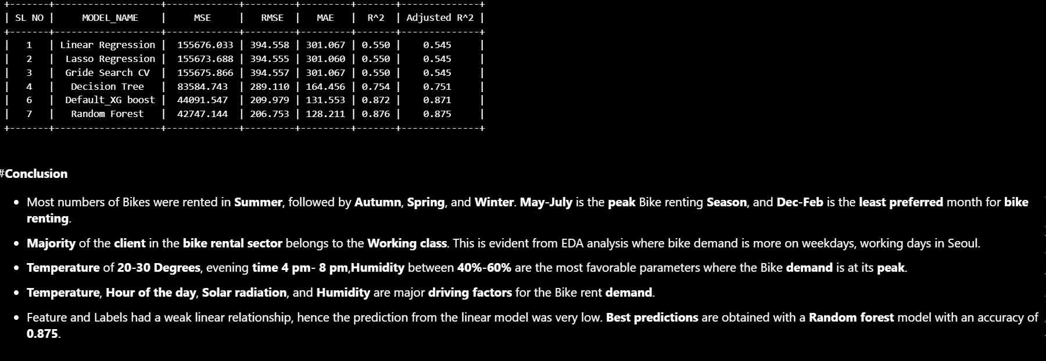
RESULT

